Slide 1
Python Revision Class
PIAIC artificial intelligence batch 3

Slide 2
Topics to cover
Conditions (if else)
Lists
Loops (for & while)
Dictionaries

Slide 3
Announcement
Quiz on coming Sunday
Python A smarter way to learn
1 – 40 Chapters

Slide 4
Data Types
What will be printed at each line?
print(type(True))
print(type(5))
print(type(5.0))
print(type(‘True’))

Slide 5
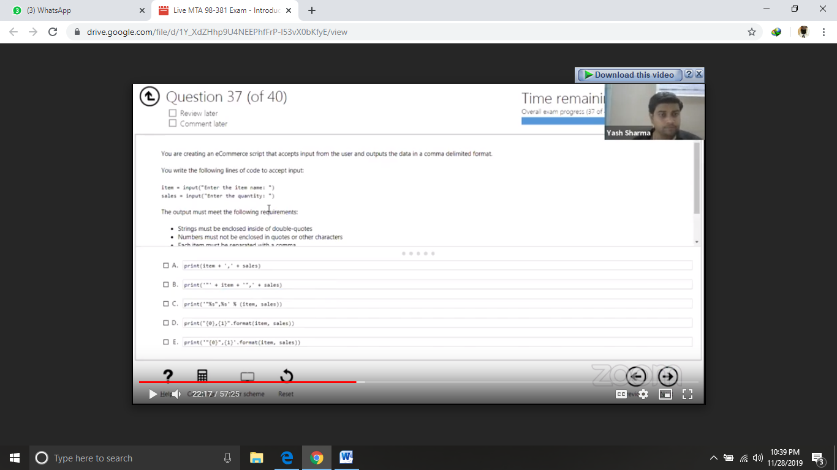

Slide 6
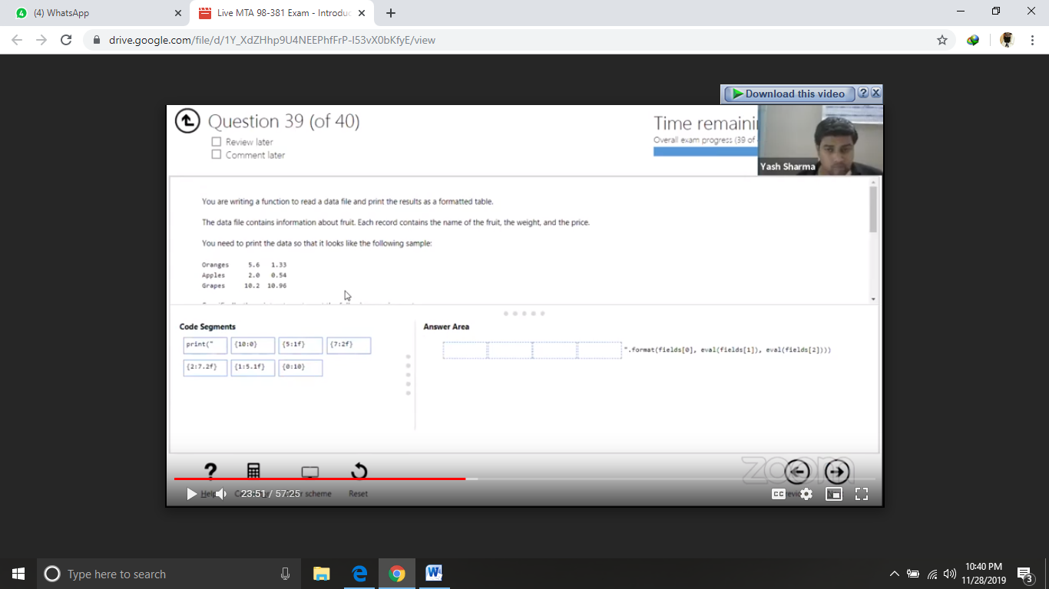

Slide 7
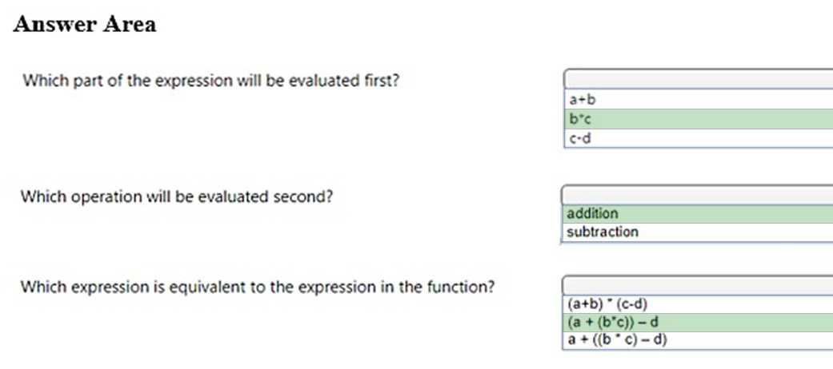
Value = a + b * c – d

Slide 8
Evaluate the following Python arithmetic expression:
3
13
15
69

Slide 9
You are creating a function that manipulates a number. The function has the following requirements:
A float is passed into the function
The function must take the absolute value of the float
Any decimal points after the integer must be removed
A. math.fmod(x)
B. math.frexp(x)
C. math.floor(x)
D. math.ceil(x)
E. math.fabs(x)
Answer: CE
Explanation:
math.floor(x) returns the largest integer less than or equal to x.
math.fabs(x) returns the absolute value of x.

Slide 10
You are writing code that generates a random integer with a minimum value of 5 and a maximum value of 11.
Which two functions should you use? Each correct answer presents a complete solution. (Choose two.)
A. random.randint(5, 12)
B. random.randint(5, 11)
C. random.randrange(5, 12, 1)
D. random.randrange(5, 11, 1)

Slide 11
What is if else?

Slide 12
Understand the flow of if else
If the condition is true
Print statement executed, program continues to next statement
If the condition is false
Print statement ignored, program continues
Only one command runs at a time (if , elif, else)

Slide 13
Example
Username = input(‘Enter Username: ’)
Password = input(‘Enter password’)
If username == ‘admin’ & password ==‘123’
Print(‘Login Successful’)
Else:
Print(‘Try again’)
print(‘End of program’)

Slide 14
Example
Username = input(‘Enter Username: ’)
Password = input(‘Enter password’)
If username == ‘admin’ & password ==‘123’
Print(‘Login Successful’)
Else:
Print(‘Try again’)
print(‘End of program’)

Slide 15
Indentation
if name == ‘Rauf ur Rahim’
Print (‘PIAIC’)
Print(‘Islamabad Batch 3’)
Print(Bahria University)
else
print(‘Name not Found’)

Slide 16
Indentation
if name == ‘Rauf ur Rahim’
Print(‘PIAIC Islamabad Batch 3’)
if class == ‘9AM’
print(‘Class 1’)
elif class == ’12PM’
print(‘Class 2’)
else
print(‘Class 3 or 4’)
else
print(‘Name not Found’)

Slide 17
Name = Rauf ur Rahim, Class = 12PM
if name == ‘Rauf ur Rahim’
Print(‘PIAIC Islamabad Batch 3’)
if class == ‘9AM’
print(‘Class 1’)
elif class == ’12PM’
print(‘Class 2’)
else
print(‘Class 3 or 4’)
else
print(‘Name not Found’)

Slide 18
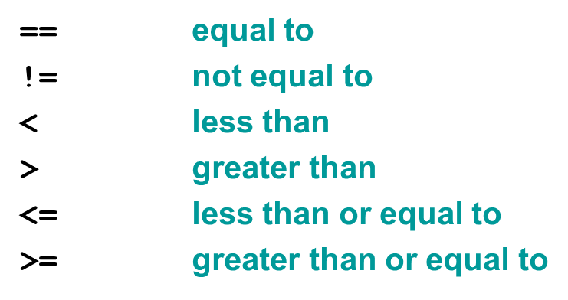
Boolean Expression

Slide 19
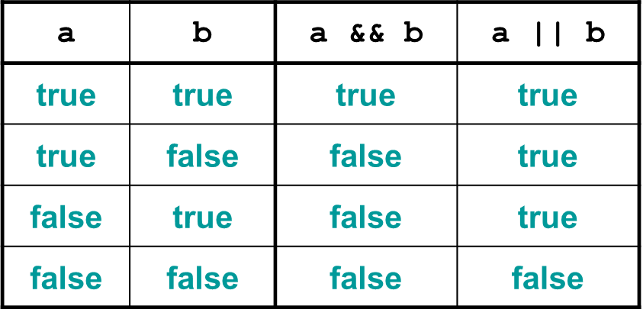
Truth Table

Slide 20
Task # 1
Write a program that receives marks from user and check the grade.
Marks greater than equal to 90 then A grade
Marks between 80 to 90, B grade
Marks between 70 to 80, C grade
Marks between 60 to 70, D grade
Marks less than equal to 60 then E grade

Slide 21
Solution
grade = int(input(‘Enter Grade Marks: ’))
if grade >= 90: print("A“) elif grade >= 80: print(“B“) elif grade >= 70: print(“C“) elif grade >= 60: print(“D“) else: print(“E“)

Slide 22
Task # 2
The ABC Video company needs a way to determine the cost that a customer will pay for renting a DVD. The cost is dependent on the time of day the DVD is returned. However, there are also special rates on Thursdays and Sundays. The fee structure is shown in the following list:
The cost is $1.59 per night.
If the DVD is returned after 8 PM, the customer will be charged an extra day.
IF DVD is scratched charge 1$ Extra
If the video is rented on a Sunday, the customer gets 30% off for as long as they keep the video
If DVD is scratched charge 2$ Extra
If the video is rented on a Thursday, the customer gets 50% off for as long as they keep the video

Slide 23
What is List?
A list (also called an array in other programming languages) is a tool that can be used to store multiple pieces of information at once. It can also be defined as a variable containing multiple other variables.
fruit = ["apple", "banana", "cherry", "orange"]

Slide 24
Understand the working / Indexing of List
Positive Indexing
fruit = ["apple", "banana", "cherry", "orange", "kiwi", "melon", "mango"]
0
1
2
3
4
5
6

Slide 25
Understand the working / Indexing of List
Negative Indexing
fruit = ["apple", "banana", "cherry", "orange", "kiwi", "melon", "mango"]
-7
-6
-5
-4
-3
-2
-1

Slide 26
Understand the working / Indexing of List
Positive & Negative Indexing (Forward)
fruit = ["apple", "banana", "cherry", "orange", "kiwi", "melon", "mango"]
Fruit [ 1 : 5] == fruit [ -6 : -2]
Fruit [ -7 : 5 : 1]
0
1
2
3
4
5
6
-7
-6
-5
-4
-3
-2
-1

Slide 27
Understand the working / Indexing of List
Positive & Negative Indexing (Backward)
fruit = ["apple", "banana", "cherry", "orange", "kiwi", "melon", "mango"]
Rules to remember:
Left to right => Positive Increment
Right to left => Negative Increment
0
1
2
3
4
5
6
-7
-6
-5
-4
-3
-2
-1

Slide 28
Increment
Fruit [ -7 : 5 : 1 ]
List Name
Starting Point
Ending Point
Increment

Slide 29
Understand the working / Indexing of List
Positive & Negative Indexing (Backward)
fruit = ["apple", "banana", "cherry", "orange", "kiwi", "melon", "mango"]
Fruit [ 4 : -7 : 1]
Fruit [ 4 : -7 : -1]
Fruit [ -3 : 0 : -1]
0
1
2
3
4
5
6
-7
-6
-5
-4
-3
-2
-1

Slide 30
Task # 1
A list named employees contains 12 employee names, the last five being company management. You need to slice the list to display all employees excluding management.
Which two code segments should you use? Each correct answer presents a complete solution. (Choose two.)
employees [1:-4]
employees [:-5]
employees [1:-5]
employees [0:-4]
employees [0:-5]

Slide 31
Employee = [E1,E2, E3, E4, E5, E6, E7, M1, M2, M3, M4, M5]
employees [1:-4]

Slide 32
Employee = [E1,E2, E3, E4, E5, E6, E7, M1, M2, M3, M4, M5]
employees [:-5]

Slide 33
Employee = [E1,E2, E3, E4, E5, E6, E7, M1, M2, M3, M4, M5]
employees [1:-5]

Slide 34
Employee = [E1,E2, E3, E4, E5, E6, E7, M1, M2, M3, M4, M5]
employees [0:-5]

Slide 35
Task
What is the output of following:
list1 = [1,2]
list2 = [4,5]
list3 = list1 + list2
list3 = list3 * 2
print( list3 )

Slide 36
What is For Loop?
For loop is used to iterate same lines of code
Multiple times
Starting , ending , increments

Slide 37
Understand the Iterations of For Loop
for i in range ( 1 , 10 , 2)
print ( i * 2 )
Output
i = 1 , i * 2 = 2
i = 3 , i * 2 = 6
i = 5 , i * 2 = 10
i = 7 , i * 2 = 14
i = 9 , i * 2 = 18

Slide 38
Nest For Loop
i = 1
for i in range ( 1 , 5)
for j in range ( 0 , 3 )
print ( i * j , end=‘ ’ )
print(‘/n’)
Output:
j= 0
i * j = 0
0

Slide 39
Nest For Loop
i = 1
for i in range ( 1 , 5)
for j in range ( 0 , 3 )
print ( i * j , end=‘ ’ )
print(‘/n’)
Output:
j= 0
j = 1
i * j = 0
i*j = 1
0
1

Slide 40
Nest For Loop
i = 1
for i in range ( 1 , 5)
for j in range ( 0 , 3 )
print ( i * j , end=‘ ’ )
print(‘/n’)
Output:
j= 0
j = 1
j = 2
i * j = 0
i*j = 1
i*j = 2
0
1
2

Slide 41
Nest For Loop
i = 2
for i in range ( 1 , 5)
for j in range ( 0 , 3 )
print ( i * j , end=‘ ’ )
print(‘/n’)
Output:
j= 0
i * j = 0
0
1
2
0

Slide 42
Nest For Loop
i = 2
for i in range ( 1 , 5)
for j in range ( 0 , 3 )
print ( i * j , end=‘ ’ )
print(‘/n’)
Output:
j= 0
j = 1
i * j = 0
i*j = 2
0
1
2
0
2

Slide 43
Nest For Loop
i = 2
for i in range ( 1 , 5)
for j in range ( 0 , 3 )
print ( i * j , end=‘ ’ )
print(‘/n’)
Output:
j= 0
j = 1
j = 2
i * j = 0
i*j = 2
i*j = 4
0
1
2
0
2
4

Slide 44
Nest For Loop
i = 3
for i in range ( 1 , 5)
for j in range ( 0 , 3 )
print ( i * j , end=‘ ’ )
print(‘/n’)
Output:
j= 0
i * j = 0
0
1
2
0
2
4
0

Slide 45
Nest For Loop
i = 3
for i in range ( 1 , 5)
for j in range ( 0 , 3 )
print ( i * j , end=‘ ’ )
print(‘/n’)
Output:
j= 0
j = 1
i * j = 0
i*j = 3
0
1
2
0
2
4
0
3

Slide 46
Nest For Loop
i = 3
for i in range ( 1 , 5)
for j in range ( 0 , 3 )
print ( i * j , end=‘ ’ )
print(‘/n’)
Output:
j= 0
j = 1
j = 2
i * j = 0
i*j = 3
i*j = 6
0
1
2
0
2
4
0
3
6

Slide 47
Final Output
0 1 2
0 2 4
0 3 6
0 4 8

Slide 48
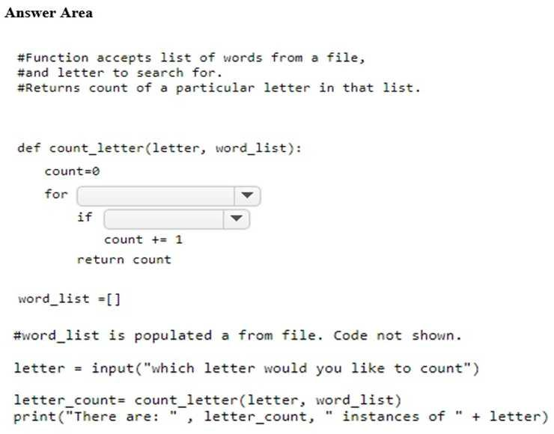

Slide 49
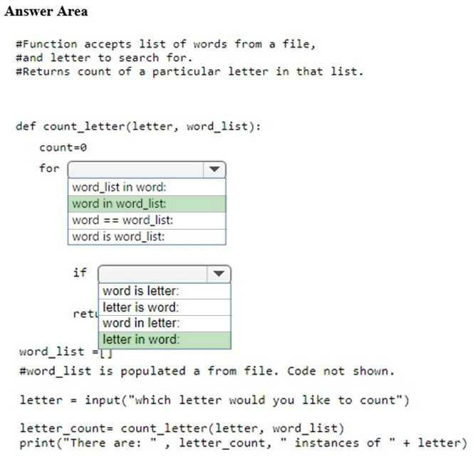

Slide 50
What is while Loop?
The while loop is used when we don't know the number of times it will repeat.
If that number is infinite, or the Boolean condition of the loop never gets set to False, then it will run forever. This is why it's an infinite loop.

Slide 51
Understand the Iterations of while Loop
if <some_condition>
do some task
while <some_condition>
keeping doing some task

Slide 52
1. sach = False
2. Counter = 0
3. While (sach != True):
4. if counter == 10:
5. sach = True
6. counter+=1
7. print(‘Yuiiiiiiiiiiiii….’)
8. print(‘Total liter= ’ + str(counter))

Slide 53
Task # 1
Take a list of 10 numbers ( 0 to 9)
Use while loop to find number 6 in list
If found print index else keep finding…

Slide 54
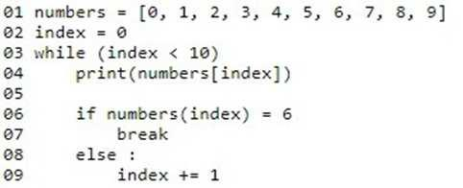
Solution

Slide 55
What is Dictionary?
A dictionary is a collection which is unordered, changeable and indexed. In Python dictionaries are written with curly brackets, and they have keys and values.

Slide 56
Why Dictionary?
List = [“Bob, 25, “Dev”, “New York”, “bob@gmail.com”]
Can store data but cannot extract information.
Name?
Age?
Job?
City?
Email?

Slide 57
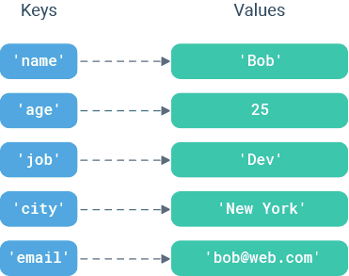
How dictionary works?

Slide 58
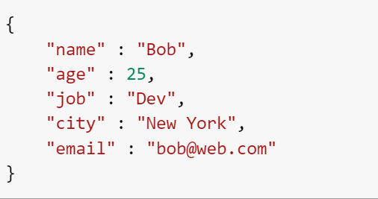
How to achieve this?

Slide 59
List VS Dictionary
List | Dictionary
Referred with a numeric index | Map key to values
Ordered | Unordered
[ ] | { }
Usually for same data type | Handle different types of data

Slide 60

What data types are supported as keys?
Integer
Float
String
Boolean
Tuples

Slide 61
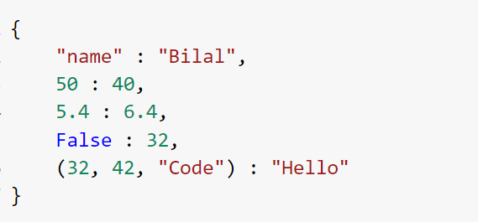
Example

Slide 62
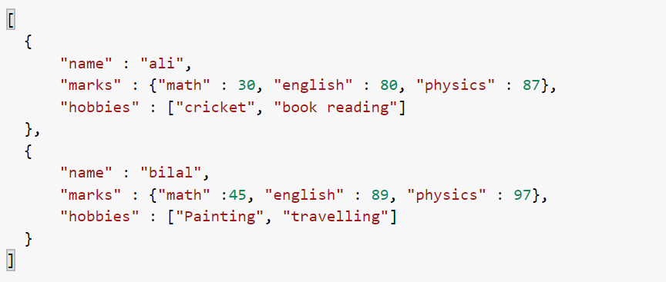
Task
Create a application to store student data. Output>

